Slide 1

Your success is our success
Locating WebElements
Funny Gorilla诙猩猩-IT培训

Slide 2
Agenda
Big Picture
How Selenium Works Logically
POM
XPath
How Selenium Works Physically
Selenium Test
Demo – Mouse Action

Slide 3
Mind map
browser tools
using the findElement(s) method
finding links
by tag name
using CSS selectors
using XPath
using tag text contents
using advanced CSS selectors
Using jQuery selectors

Slide 4
Using browser tools
for inspecting elements and page DOM
Chrome Developer Tool
https://yizeng.me/2014/03/23/evaluate-and-validate-xpath-css-selectors-in-chrome-developer-tools/

Slide 5
findElement method

Slide 6
findElements method

Slide 7
Finding links

Slide 8
By tag name

Slide 9
Using CSS Selector

Slide 10
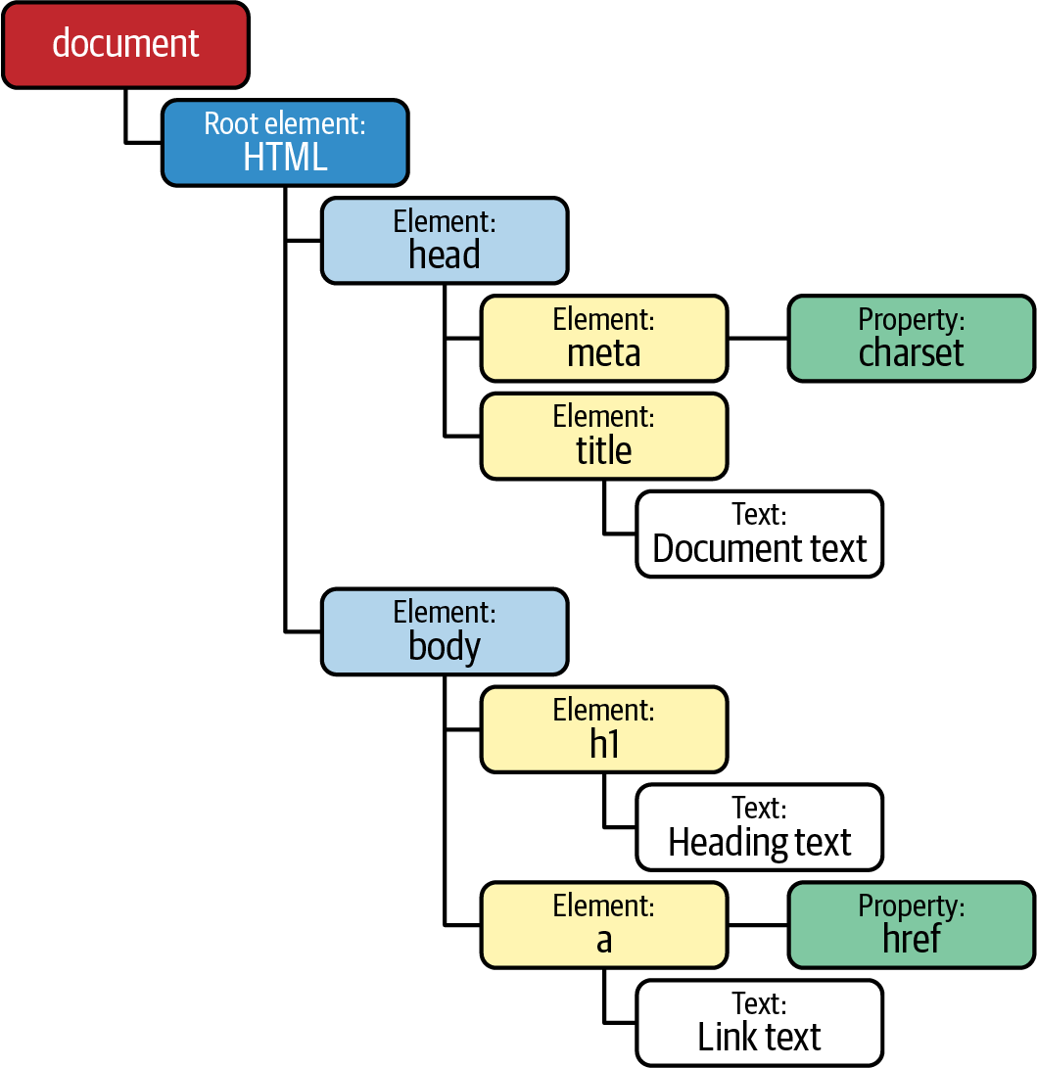
Understand Web Page Object Model (POM)
HTML + CSS + JavaScript
<HTML>
<HEAD>
<TITLE>Your Title Here</TITLE>
</HEAD>
<BODY BGCOLOR="FFFFFF">
<CENTER><IMG SRC="clouds.jpg" ALIGN="BOTTOM"> </CENTER>
<HR>
<a href="http://somegreatsite.com">Link Name</a>
is a link to another nifty site
<H1>This is a Header</H1>
<H2>This is a Medium Header</H2>
Send me mail at <a href="mailto:support@yourcompany.com">support@company.com</a>.
<P> This is a new paragraph!
<P> <B>This is a new paragraph!</B>
<BR> <B><I>This is a new sentence without a paragraph break, in bold italics.</I></B>
<HR>
</BODY>
</HTML>

Slide 11
Using XPath

Slide 12
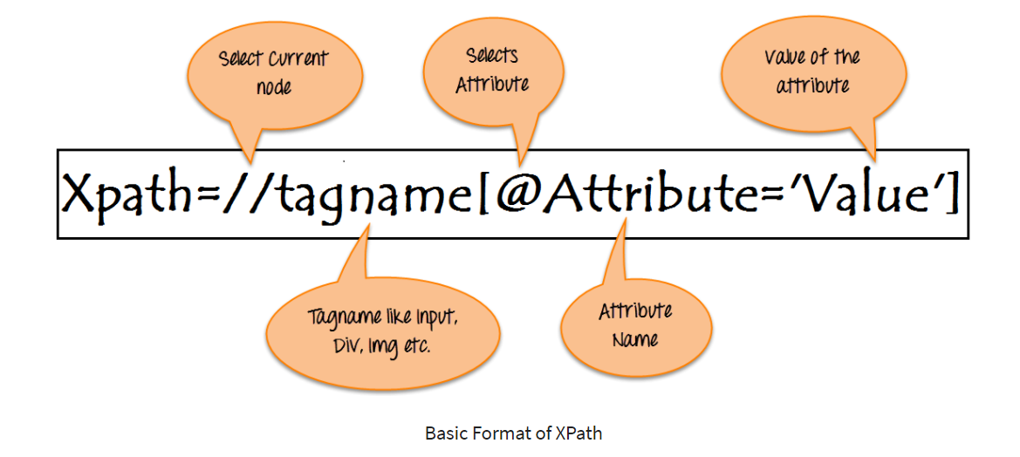
XPath

Slide 13
using tag text contents

Slide 14
Using jQuery selectors

Slide 15
References
XPath – Html Table
https://www.guru99.com/selenium-webtable.html

Slide 16
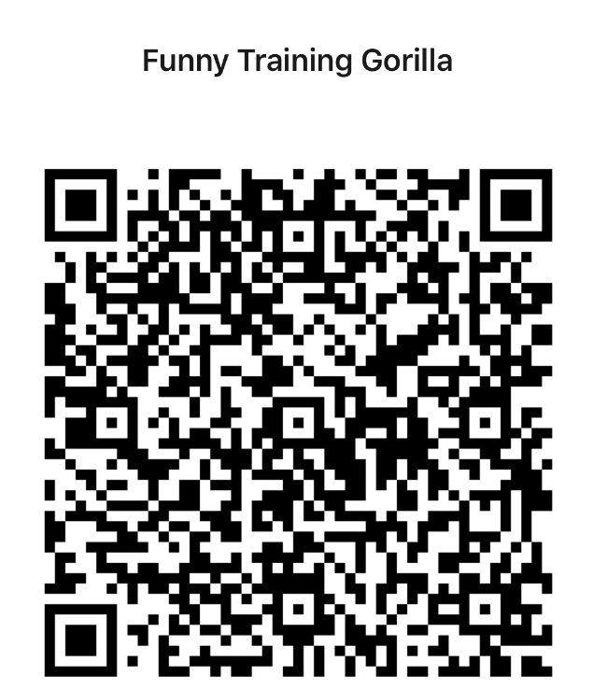
Contact
WebSite: www.funnygorilla.com.au
Mail: info@funnygorilla.com.au
Linkedin: https://mt.linkedin.com/in/songqing-gu-2ba9034b/de
WebChat: Funny Training Gorilla
Phone: 0420891343

